Slide 1
Shor’s Algorithm
Factorization of a number
不正经讲师：理科宅Hunt

Slide 2
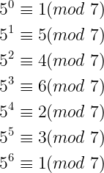

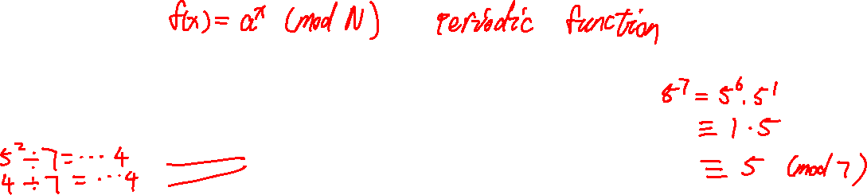
Number theory
If $a$ and $b$ have the same remainder (余数) when divided by $N$, then we say $a$ is congruent to (同余) $b$, denoted as
$$a≡b \left(mod N\right)$$
The remainder of $a^{x}$ when divided by $N$ is periodic. The smallest number $r≠0$ such that $a^{r}≡1 (mod N)$ is called order(阶) of $a$ modulo $N$.
Example: The order 5 modulo 7 is 6.

Slide 3

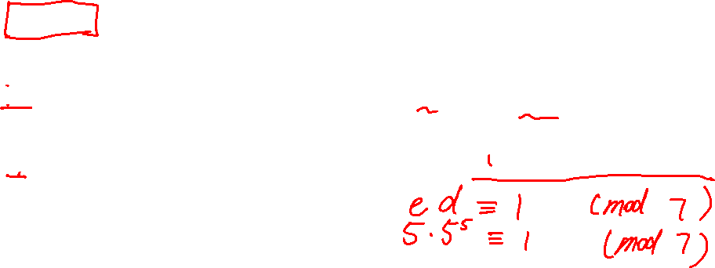
RSA encryption
Let $N=pq$ where $p$ and $q$ are prime numbers.
The Euler’s totient function(欧拉函数), $φ\left(N\right)=(p−1)(q−1)$.
Let $e$ be a number between 1 and $φ(n)$, $1<e<φ(N)$, such that $e$ is coprime(互质) to $φ(N)$.
Let $d$ be the inverse(逆元) of $e$ modulo $φ\left(N\right)$, $ed≡1 (mod φ(N))$.
Public key(公钥): $N,e$
Private key(密钥): $N,d$
Public key is to encrypt(加密) info; Private key is to decrypt(解密) info.

Slide 4

RSA encryption (continued)
Public key are public, everyone can use it to encrypt info.
Private key is only visible to the receiver.
RSA relies on the fact that large number is hard to factor!
If one can factor $N$ into $pq$, then he/she knows your private key!

Slide 5
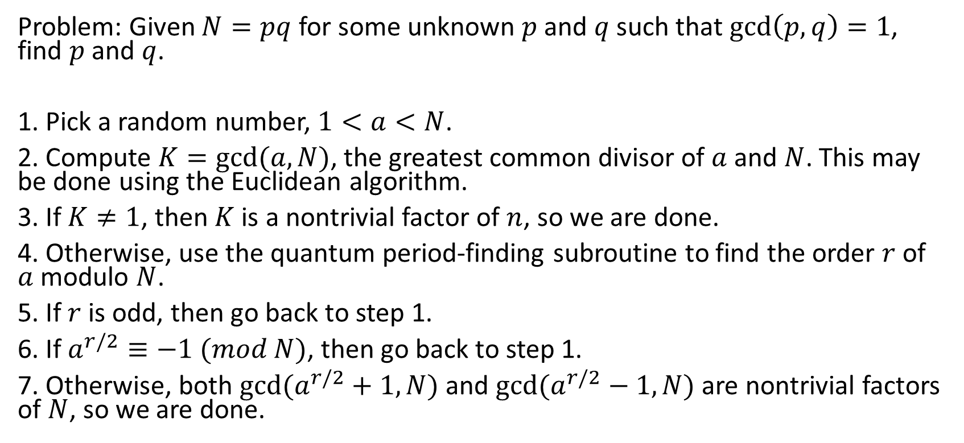
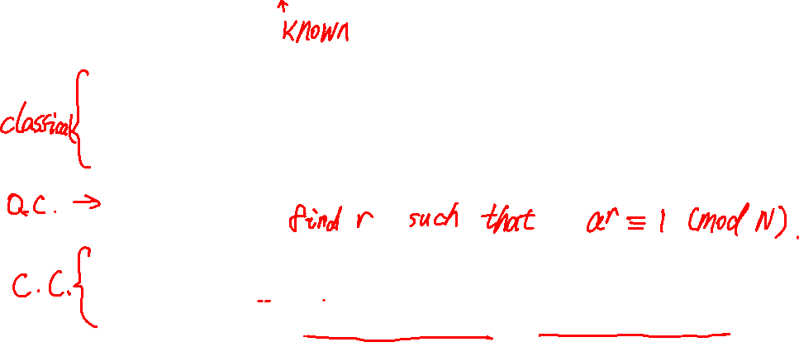
Shor’s algorithm
Problem: Given $N=pq$ for some unknown $p$ and $q$ such that $\gcd\left(p,q\right)=1$, find $p$ and $q$.
1. Pick a random number, $1<a<N$.
2. Compute $K=gcd(a,N)$, the greatest common divisor of $a$ and $N$. This may be done using the Euclidean algorithm.
3. If $K≠1$, then $K$ is a nontrivial factor of $n$, so we are done.
4. Otherwise, use the quantum period-finding subroutine to find the order $r$ of $a$ modulo $N$.
5. If $r$ is odd, then go back to step 1.
6. If $a^{r/2}≡−1 (mod N)$, then go back to step 1.
7. Otherwise, both $gcd⁡(a^{r/2}+1,N)$ and $gcd⁡(a^{r/2}−1,N)$ are nontrivial factors of $N$, so we are done.

Slide 6

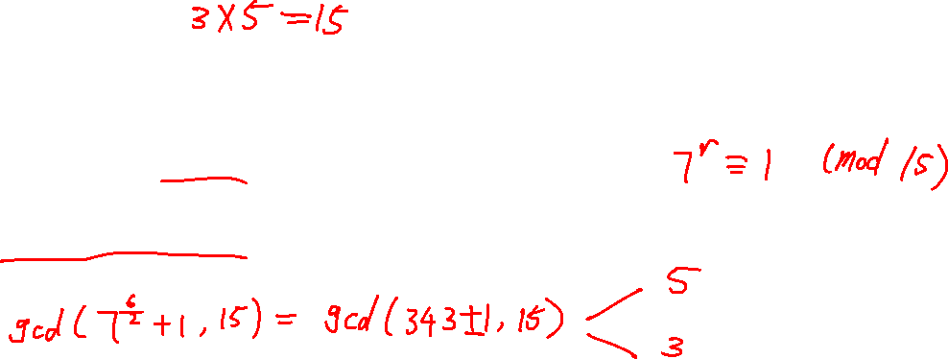
Example
Suppose $N=15$, how to factor it?
1. Pick a random number, $1<a<N$. Say, $a=7$
2. $K=gcd\left(a,N\right)=1$. It is trivial, we need to find the order of $a$.
4. The order $r=6$ since $a^{6}≡1 (mod N)$.
5. $\gcd\left(a^{\frac{r}{2}}+1,N\right)=5$ and $\gcd\left(a^{\frac{r}{2}}−1,N\right)=3$ are nontrivial factors of $N$.

Slide 7
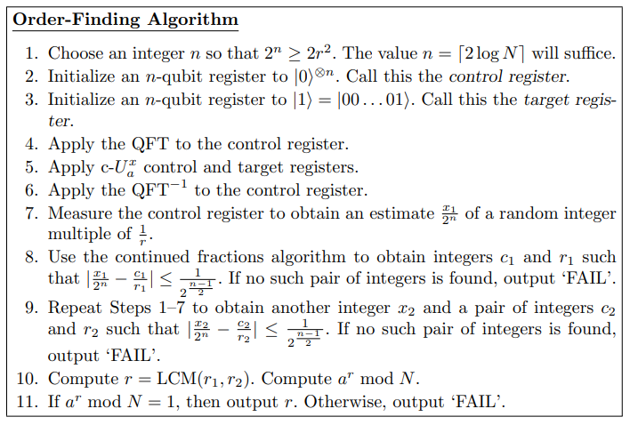
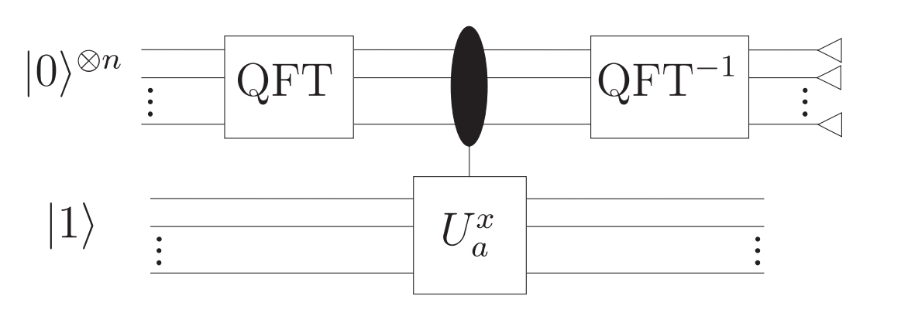
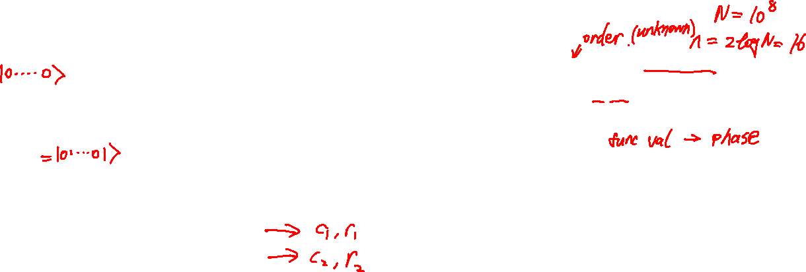
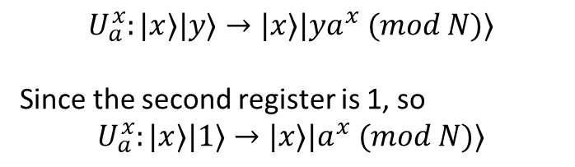

Shor’s algorithm (Quantum subroutine)
The quantum part of Shor’s algorithm is for order-finding.
$$U_{a}^{x}:|x⟩|y⟩→|x⟩|{ya}^{x} (mod N)⟩$$
Since the second register is 1, so
$$U_{a}^{x}:|x⟩|1⟩→|x⟩|a^{x} (mod N)⟩$$

Slide 8
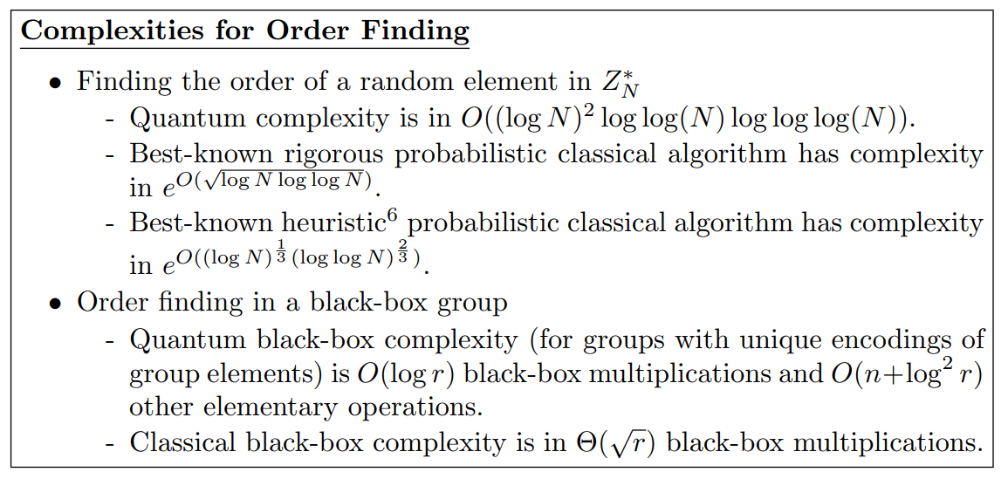
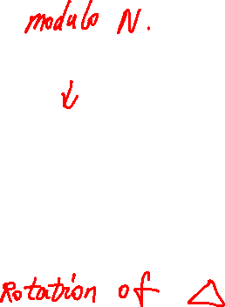

Time-complexity

Slide 9

Summary
Shor’s algorithm can factor number in polynomial time (some polynomial of $\log{N}$).

